Slide 1
Random Graphs

Slide 2
The G(n,m) model
Ensemble: the set of simple networks with n vertices and m edges
For a graph G in G(n,m),
is the size of G(n,m).
Let be the diameter of a graph G
Then the mean diameter

Slide 3
The G(n,p) model
There are n vertices.
With probability p, we place an edge independently between each distinct pair.
First studied by Solomonoff and Rapoport in 1951.
Erdos and Renyi published a series of papers on this model.
For a sample G in G(n,p) with m edges,
The probability of drawing a graph with m edges is then

Slide 4
The mean degree in the G(n,p) model
The mean value of m is
This is a direct result of the binomial distribution as there are n(n-1)/2 independent Bernoulli random variables with parameter p.
The mean degree in a graph with m edges is 2m/n. Thus the mean degree in G(n,p) is

Slide 5
Degree distribution
A given vertex in G(n,p) is connected with probability p to each of the n-1 other vertices.
The degree of of a given vertex is thus a random variable with the binominal distribution B(n-1,p), i.e.,
Let the mean degree c=(n-1)p be fixed as n goes to
Then the binomial distribution B(n-1,p) converges to the Poisson distribution with mean c, i.e.,
This is called Poisson random graph (as the limit of the Erdos and Renyi random graph)

Slide 6
Clustering coefficient
The clustering coefficient C is a measure of transitivity.
It is defined as the probability that two network neighbors of a vertex are also neighbors of each other.
As each edge is connected independently with probability p,
This is one of several aspects that the random graph differs sharply most from real-world networks.

Slide 7
Giant component
Consider the Poisson random graph
For the case p=0, there are no edges in the network at all. Each vertex is completely isolated.
For the case p=1, every possible edge in the network is present and the network is an n-clique.
Phase transition: an interesting question is how the transition between the two extremes occurs if we increase p from 0 to 1.
Giant component: a network component whose size grows in proportion to n.

Slide 8
The size of the giant component
Let u be the average fraction of the vertices in the random graph that do not belong to the giant component.
Suppose that a randomly chosen vertex i does not belong to the giant component (with probability u).
For any other vertex j
  Either i is not connected to j (with probability 1-p),
  or i is connected to j but j itself is not a member of the giant component (with probability pu).

Slide 9
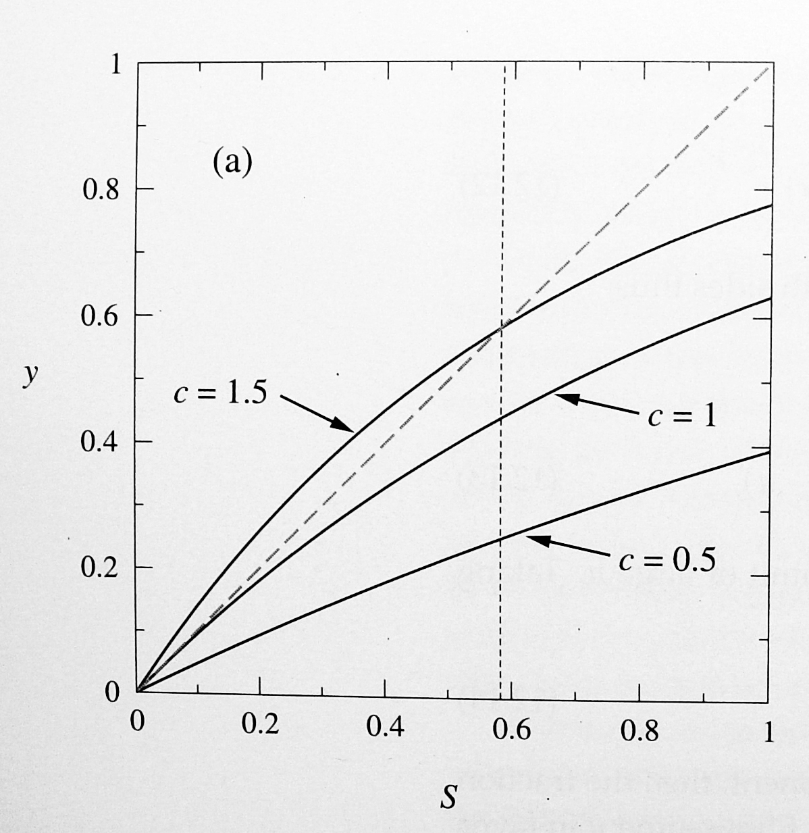
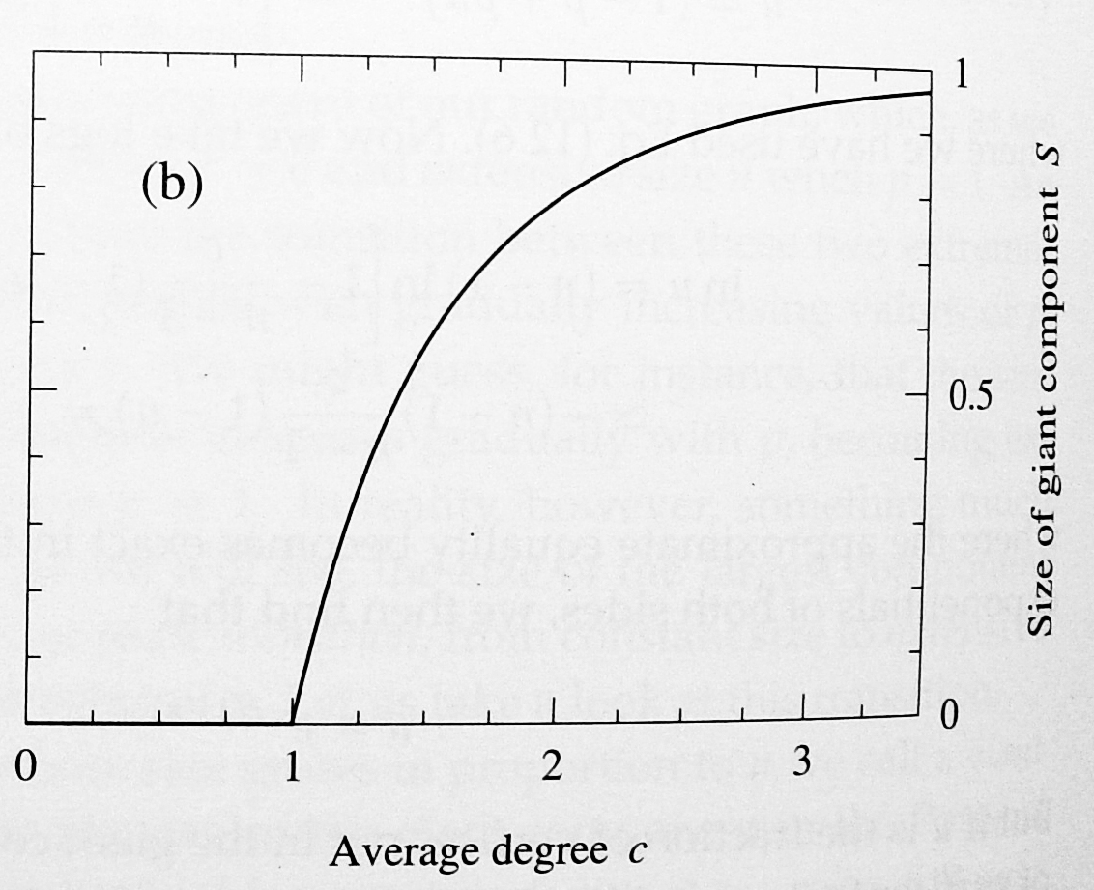
The size of the giant component and phase transition
Let S=1-u be the fraction of vertices in the giant component.
The transition take place at c=1.

Slide 10
Intuitive argument by the growth of a vertex set
Core and periphery of a vertex set
  Core: the vertices that have connections only to other vertices in the set.
  Periphery: the vertices that have at least one neighbor outside the set.
For a vertex set with size s, there are n-s vertices outside the set and the average number of connections a vertex in the periphery has to outside vertices is
If c>1, the average size of the periphery will grow exponentially by the factor c.

Slide 11
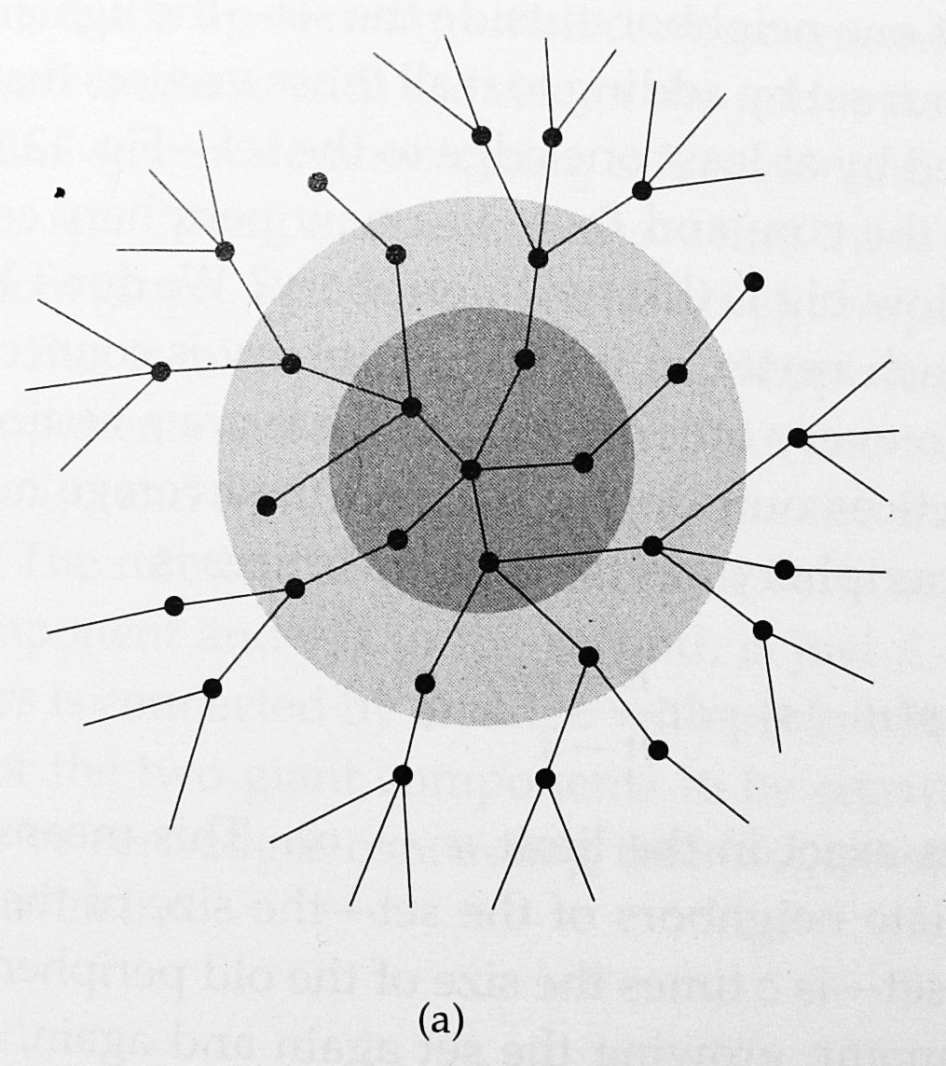
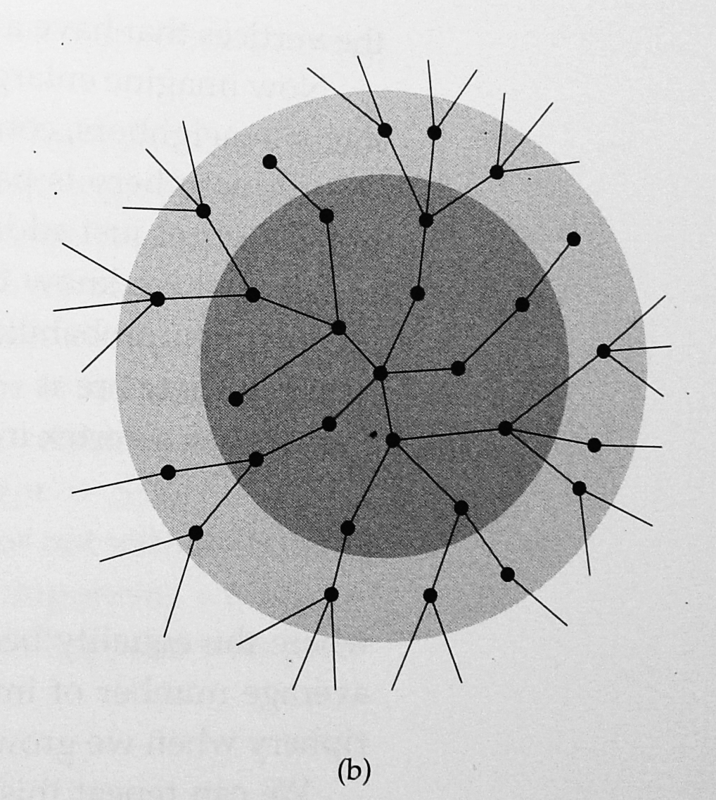
The growth of a vertex set
A set of vertices (inside the gray circle) consists of a core (dark gray) and a periphery (lighter).

Slide 12
Small components
For c>1, there exists a giant component. What is the structure of the remainder of the network?
The first step is to show that there are only small components left that do not increase in proportion to the size of the network.
We know that the giant component is with size Sn. Suppose there is another component with size S₂(n). Then the number of distinct pairs of vertices (i,j) with i in the giant component and j in the second component is SnS₂(n).

Slide 13
Small components
As these two components are separated, there are no edges between all these pairs of vertices, which happens with probability q(n) given by
Thus, the probability that there exists another component with the size that goes to infinity is 0.
All the non-giant components are small components that have sizes independent of the network size n.

Slide 14
Small components
For c<1, there does not exist a giant component.
We will argue that all the components in this case are also small components (that have sizes independent of the network size n).
Let X be the size of the component of a randomly chosen vertex i.
Suppose that vertex i has K neighbors, n₁, n₂, …,n_{K}.
Let X_{j}, j=1,..,K, be the size of the component of n_{j} after vertex i being removed from the graph.

Slide 15
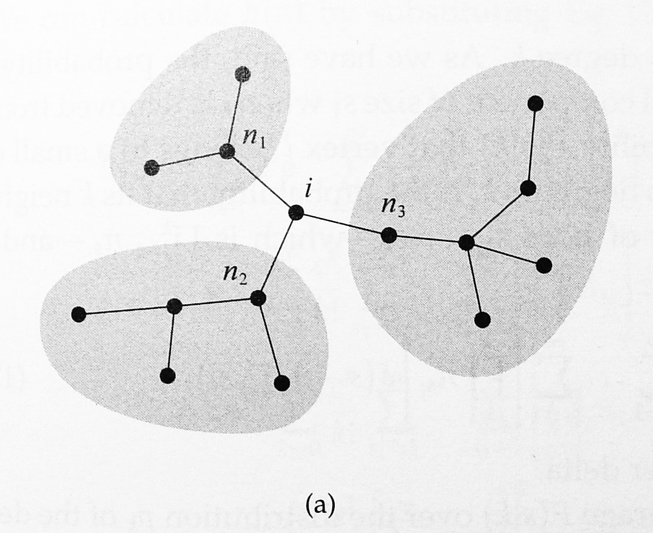
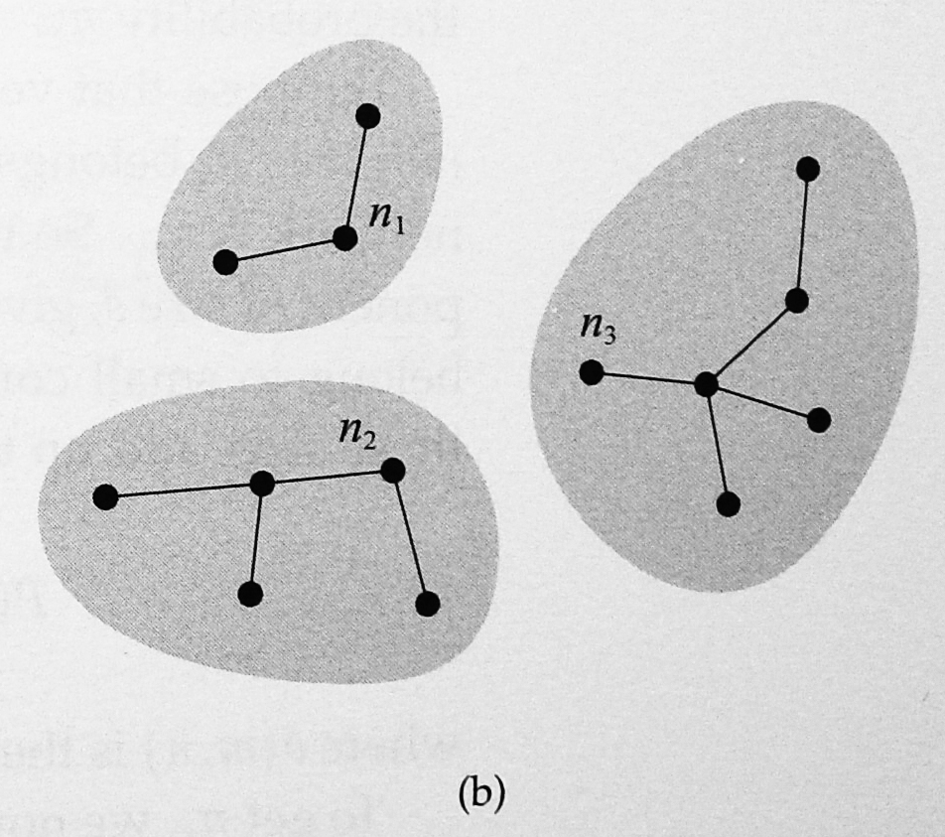
Small components

Slide 16
Small components
Removing vertex i yields a sample graph in G(n-1,p). When n is large, X, X_{j}’s have the same distribution.
Note that
The expected size of the component of a randomly chosen vertex is independent of the size of the network n.

Slide 17
Small components are trees
Consider a component with size s.
Suppose that T is a spanning tree in this component.
Note that the tree T has s-1 edges.
Thus, the number of edges that are in S\T is bounded above by
The expected number of edges that are in S\T is bounded above by

Slide 18
The size of a small component
Let be the probability that a randomly chosen vertex is in a small component of size s.
where S is the fraction of vertices in the giant component.

Slide 19
The size of a small component
Consider a vertex i in a small component of size s. Suppose that the degree of vertex i is k.
Let n₁,n₂, …, n_{k} be the k neighbors of vertex i.
The probability that n_{j} belongs to a small component of size s_{j} after vertex i being removed is
So the probability P(s|k) that vertex i belongs to a small component of size s, given that the degree is k, is the probability that its k neighbors belongs to small components of size s₁, s₂,…,s_{k}, and these sizes add up to s-1.

Slide 20
The size of a small component
Thus, we average P(s|k) over the distribution p_{k} of the degree to get

Slide 21
Generating functions (z-transform)
The generating function
Given h(z), we can recover the probabilities by differentiating:

Slide 22
A self-consistent equation for h(z)

Slide 23
The mean size of the small component to which a randomly chosen vertex belongs
To find

Slide 24
The size of a small component for the case c<1 by using random variables
Let X be the size of the component of a randomly chosen vertex i given that vertex i is in a small component.
Suppose that vertex i has K neighbors, n₁, n₂, …,n_{K}. (K is a Poisson random variable with mean c)
Let X_{j}, j=1,..,K, be the size of the component of n_{j} after vertex i being removed from the graph.
Then

Slide 25
The size of a small component
Let h(z) be the moment generation function of X.

Slide 26
The size of a small component for the case c>1
Let be the probability that a randomly chosen vertex is in a small component of size s.
Let be the conditional probability that a randomly chosen vertex is in a component of size s given that the randomly chosen vertex is in a small component.
Note that

Slide 27
The size of a small component for the case c>1 by using random variables
Let X be the size of the component of a randomly chosen vertex i given that vertex i is in a small component.
Suppose that vertex i has K neighbors, n₁, n₂, …,n_{K}. (K is a Poisson random variable with mean c(1-S) why?)
Let X_{j}, j=1,..,K, be the size of the component of n_{j} after vertex i being removed from the graph.
Then

Slide 28
The size of a small component for the case c>1 by using random variables
Let be the moment generation function of X.

Slide 29
Conjugate distribution
Conditioning on that a randomly chosen vertex is in a small component (i.e., it is not in the giant component), the degree distribution of the chosen vertex is changed from the original Poisson distribution with mean c to the conjugate distribution with mean c(1-S).
To see this, note that the Poisson random graph is the limit of the G(n,p) model with c=(n-1)p.
The degree distribution is binomial B(n-1,p) in the G(n,p) model.

Slide 30
Conjugate distribution
The giant component contains (roughly) Sn vertices.
Given that the chosen vertex is not in the giant component, the chosen vertex has no connection to the Sn vertices in the giant component.
Given that, the number of possible connections is then the sum of n(1-S) Bernoulli random variables with mean p.
Thus, the degree distribution then becomes binomial B(n(1-S),p).
As a limit, the conjugate degree distribution is Poisson with mean c(1-S).

Slide 31
Average size of a small component
Recall that is the probability that a randomly chosen vertex is in a small component of size s.
is not strictly the average size of a small component, but the average size of the component to which a randomly chosen vertex belongs.
Larger components have more vertices.
is a biased estimate of the actual average component size.

Slide 32
Average size of a small component
Let n_{s} be the actual number components of size s in the sample graph.
The number of vertices that belongs to components with size s is sn_{s}.
Hence the probability that a randomly chosen vertex in a small component of size s is
The average size of a component, denoted by R, is

Slide 33
Average size of a small component
Note that
From
We have

Slide 34
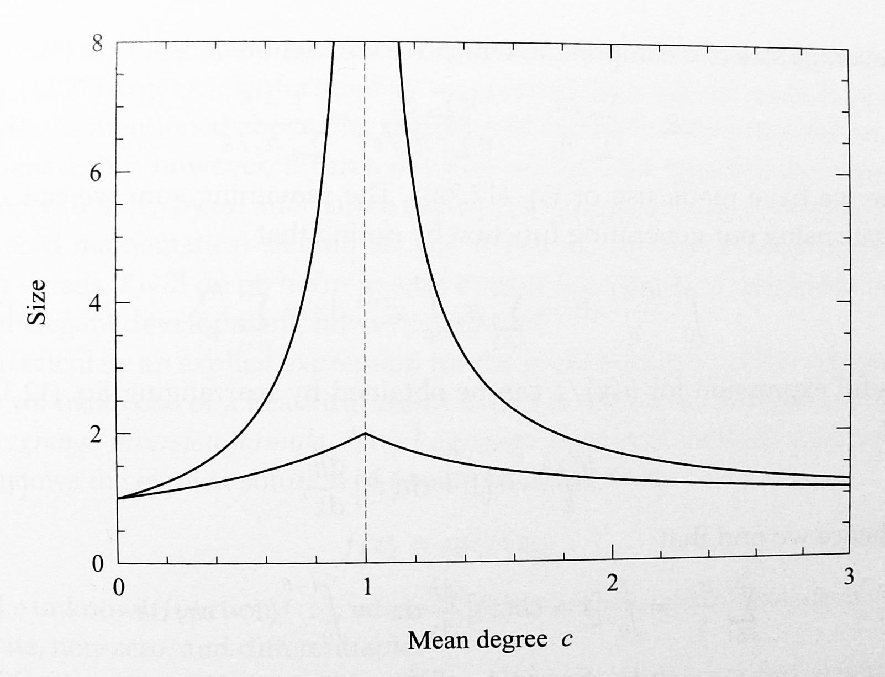
Average size of a small component

Slide 35
The complete distribution of component sizes
Find from
Lagrange inversion formula: a formula that allows the explicit solution of equations of the form for the unknown function f(z), where is a known function which at f=0 is finite, non-zero, and differentiable.
Write f(z) as a series expansion

Slide 36
Cauchy’s formula
Cauchy’s formula for the nth derivation of a function g(z) at z=z₀ says that
where the integral is around a contour that enclose z₀ in the complex plane but encloses no poles in g(z).
With , z₀=0, and n=s-1,
where the integral is around a contour in f.

Slide 37
Cauchy’s formula
Write
From Cauchy’s formula, it then follows the Lagrange inversion formula
Need to show that the contour followed by f surrounds the origin.

Slide 38
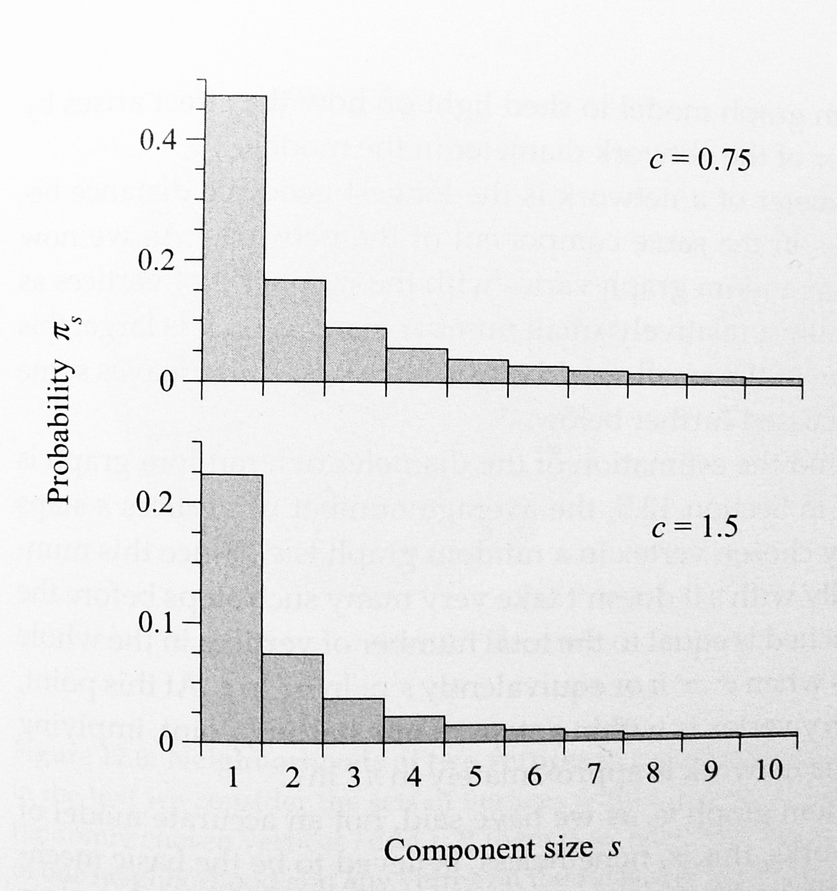
The complete distribution of component sizes
We set

Slide 39
Conjugate distribution
For c>1, we replace c by c(1-S) for

Slide 40
Path lengths
Basic idea: the average number of vertices s steps away from a randomly chosen vertex is c^{s}.
The number of steps to reach all the vertices is then roughly when
Thus the diameter is approximately
The above argument is only an approximation. It breaks down when c^{s} becomes comparable to n.

Slide 41
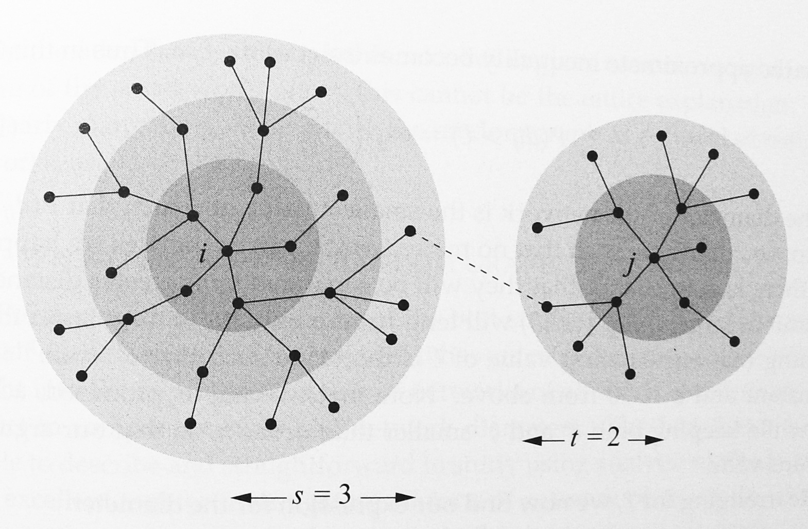
Path lengths
Consider two vertices i and j.
The “ball” within distance s from vertex i roughly contains c^{s} vertices.
The “ball” within distance t from vertex j roughly contains c^{t} vertices.

Slide 42
Path lengths
The (geodesic) distance between vertices i and j is greater than d+1 if and only if there are no edges between the s-ball of vertex i and the t-ball of vertex j for any s and t such that d=s+t.
For any fixed s and t, there are on average c^{s}xc^{t} pairs of vertices.

Slide 43
Path lengths
If grows faster than n, then the probability approaches to 0.
for some constant a and
The constant A is known (in the literature).

Slide 44
Problems with random graphs
The clustering coefficient in a random graph is C=c/(n-1), which is quite small for large n.
This differs from the clustering coefficient of the real acquaintance network.
Random graphs do not have correlation between adjacent vertices (assortativity).
Random graphs do not show community structure.
The degree distribution in a real network might be scale free (not Poisson).

